Slide 1
Welcome to Year 4
Respect Responsibility Compassion Courage Forgiveness Truthfulness

Slide 2
Teachers – Mrs Manners and Mrs Duffy
PPA teacher – Mrs Britton (Wednesday afternoon)
TAs – Mrs Pilkington, Mrs Hajra, Miss Bayliss, Mrs Colson.
Respect Responsibility Compassion Courage Forgiveness Truthfulness

Slide 3
PE
Monday and Friday
Please wear kit to school on PE days
School PE top, jogging bottoms/shorts, trainers, school jumper
Swimming (after Easter)- Wednesday afternoons
Respect Responsibility Compassion Courage Forgiveness Truthfulness

Slide 4
Topics
Autumn Term – The Victorians
Spring Term – The Vikings
Summer – Brazil
Respect Responsibility Compassion Courage Forgiveness Truthfulness

Slide 5
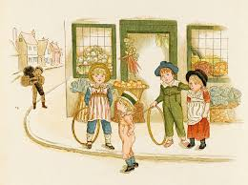
Arts and P.E.
(Art/D&T/Music/P.E)
Explore the work of William Morris and create their own clay tile.
Design and make an electric rat catcher for Jacko the rat catcher
Children will compose short pieces of music to develop musical vocabulary.
Hockey & Real PE - Personal
Our Values will be:
Respect & Responsibility
English
Writing stories
Information texts
Poetry
Plays
Spelling
homophones, prefixes: in,im,il,ir, sion, scion, cian, ssion, ough
Year 4 - The Victorians
AUTUMN 2021
History
Who were the Victorians and when did they live?
Explore the lives of Victorian people of significance within our locality, e.g. Queen Victoria and Isambard Kingdom Brunel.
Who was Prince Albert and how did he die?
How were trains made?
Did anyone ever betray Queen Victoria?
Who were the richest people in Victorian times and why?
Who were and what was it like to be a street child?
Why didn’t they have good medicine?
What was it like to be in a Victorian school?
How many Victorian inventions have been important for the world today?
How many and what type of toys did Victorian children have?
Why did children sweep chimneys?
How were Victorian footballs made?
What did Florence Nightingale do and which medicines did she use?
What were rich people called?
What made the Victorian era so important?
Science
Electricity
Why does the circuit not work?
Where does electricity come from?
Which materials does electricity pass through?
What does a switch do?
What happens when we add more batteries or bulbs to a circuit?
How does electricity get into our house?
Sound
How are sounds made?
How do we hear sound?
How does pitch change?
How does volume change?
How is sound affected by distance?
Special Events
Launch Day – Victorian activity day.
Art – Create a clay tile in Art
Harvest festival and Christmas service
Possible trip to The Black Country Museum
Topic outcomes include…
A story set in Victorian times.
A story that raises an issue for a Victorian child.
An information page about famous Victorians.
Artwork inspired by William Morris
An electric rat catcher.
Computing
E-safety - Media balance and well-being
Shape - Exploring loops and sequence to repetition
R.E and P.S.H.C.E
RE:
What is the Trinity and why is it important for Christians?
What do Hindu’s believe God is like?
PSHCE
Fundamental British Values – Citizenship & Rules
Relationships with family and friends (positive touch)
Apple - Friendship, solving problems
Kindness & Anti Bullying
French
Where I live
Alphabet
Places in Town/Directions
Maths
Number and place value, Geometry - properties of shape, multiplication, division, addition and subtraction.
Notes:
5

Slide 6
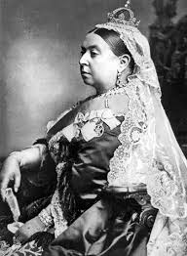
VICTORIANS
(knowledge organiser.)
Vocabulary Dozen
Chronological | The arrangement of events or dates in the order of their occurrence.
Monarchy | A form of government with a king or queen at the head.
Artefact | An object made by a human being, typically one of cultural or historical interest.
Throne | A ceremonial chair for an important figure.
Invention | The action of making something.
Engineering | The designing, building, and use of engines, machines, and structures.
Orphan | A child who has no parents.
Victorian | A person who lived during the Victorian period.
Education | The process of learning new ideas in a school environment.
Street-child | A child who does not have a home and sleeps in the streets.
Empire | A large group of states or countries ruled over by a single monarch.
Laws | Rules that people in the country have to follow.
Key figures
Queen Victoria Prince Albert Isambard Kingdom Brunel Dr Barnardo Lord Shaftesbury
Key learning skills | In context of our topic
To find out about key figures | Key figures as above
To investigate key events | Important events that shaped the Victoria period and changed lives.
To ask questions | About people and events in Victorian England.
To describe new achievements | Inventions during the period.
To compare lives from the past to the present day | Children’s lives How jobs are different
To know and understand about the past | To be able to talk about Victorian England.

Slide 7
.
Year 4 Homework Activities
Spellings - new spellings will be given out in the spelling folder on Fridays and tested the following Friday. Please make sure the spelling folder is in school every Friday. The first spelling test will take place on 24.9.2021
Reading - remember to read for at least 20 minutes a day
Times tables - continue to practise your times tables (by the end of year 4 you need to know up to 12x12)
Maths homework will be given out in the maths folder on a Monday and is due in the following Monday. During the Monday number sense lesson we will go through the homework together so please make sure the folder is in school. One week it will be a times table activity and the other week will be based on class work. The first piece will be due in on 20.9.2021
Topic homework - each week choose one activity and complete it in your homework book. Please bring your completed homework in on a Wednesday and put it in the homework box. Your book will be returned to you by Friday. The first piece is due in on 29.9.2021 and the final piece is due in on 1.12.2021
If you have any questions about homework in Year 4 please speak to us.

Slide 8
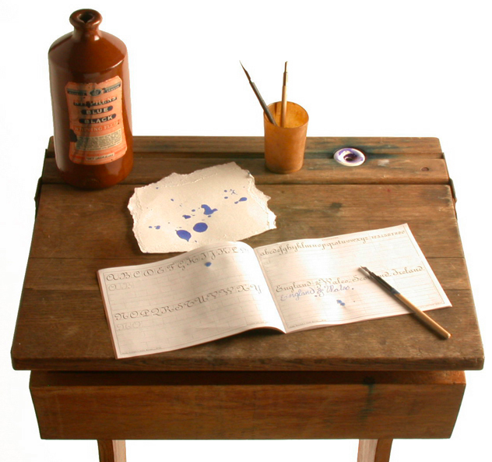
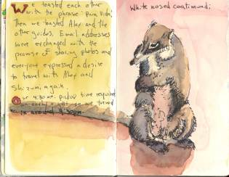
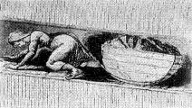
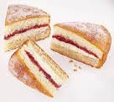
English/Topic Activities
Activity 1 – Famous Victorians
Who is your favourite famous Victorian? There were many people during Victorian times who are still remembered today. Research one who inspires you and write
a fact file about that
person.
Activity 7 - Read all about it!
Write a news report about one invention and the impact it had on the lives of the Victorian people. You could write about the steam train, telephone or even coca cola or the jelly baby!
Activity 5 – Great Inventions
Many items that we use today were invented in the Victorian period. What would you invent now to make your life easier? Draw a labeled diagram of your invention and write a paragraph explaining how it works.
Activity 8 – A day in the life
Research what life would be like for
a Victorian child and write a diary entry for them. You could be a rich child or a poor child, chimney sweep, factory worker or one of Queen Victoria’s children.
Activity 2 – Handwriting
Victorian school children took great pride in their handwriting. Find a piece of writing that
you enjoy and copy it into your
homework book, using your
best handwriting. Remember
to keep it joined and letters an even size.
Activity 6 – Junk Invention
Complete this activity either before or after Activity 5. Use whatever junk materials you can find and make a model of your invention.
Activity 9 – Child Labour
Lord Shaftesbury campaigned to stop Victorian children working in difficult conditions, such as in the coal mines
and factories. Design a poster persuading people to support his cause.
There are many websites that
provide information on this.
Activity 3 – Nature Study
A popular activity for Victorian
children involved looking for natural
objects and creatures. Keeping your
eyes wide open, find something from
nature that you want to write a
short information page about. Include a drawing.
Activity 10 – Storytime
Reading fairy stories was as popular in
Victorian times as it is today. Write your
own short fairy story that could be read
to a young child. Remember to start with
‘Once upon a time ………………
Activity 4 – Perfect Poetry
All Victorian children would have a party piece that they would perform or say when required. This might be a poem that they would memorise. Choose a poem, modern or Victorian, copy it into your book and learn
it off by heart. You may be asked to perform
it!
Activity 11 – Victoria Sponge
Find a recipe for a Victoria sponge. Copy it into
your book then follow the recipe to make this
delicious cake. Enjoy!

Slide 9
Reading
Evidence suggests that children who read for enjoyment every day not only perform better in reading tests than those who don’t, but also develop a broader vocabulary, increased general knowledge and a better understanding of other cultures.
In fact, reading for pleasure is more likely to determine whether a child does well at school than their social or economic background.
There will be set time in school each day for children to read for pleasure and be read to. We have a set of Year 4 ‘must reads’ and ‘recommended reads’. These will be added to throughout the year. Any other book donations will be gratefully received!
Respect Responsibility Compassion Courage Forgiveness Truthfulness

Slide 10
Growth Mindset
Its ok to make mistakes
Learning should be challenging
Respect Responsibility Compassion Courage Forgiveness Truthfulness

Slide 11
Attendance
An attendance rate of 97% is generally considered good; this allows for children to miss 9.5 days across the school year.
School start time is 8.55
Activities start as soon as children arrive so being on time is very important. It can be disruptive for children who arrive late and have missed the start of lessons.
Respect Responsibility Compassion Courage Forgiveness Truthfulness

Slide 12
Ready to Learn
Water bottle (reusable)
Healthy snack for break time
Coat (with a hook) Everyday!
Reading book
Wear PE kit on PE days – Monday and Friday
Homework
Breakfast
Enough sleep
Named uniform – especially jumpers
Long hair tied back
Stud earrings (taken out for PE days/masking tape)
No pencil cases or toys
Respect Responsibility Compassion Courage Forgiveness Truthfulness

Slide 13
PTFA
ptfa.chair@holytrinity.gloucs.sch.uk
Cake sale – Spring/summer
Money for trips and extra activities
Respect Responsibility Compassion Courage Forgiveness Truthfulness

