Slide 1








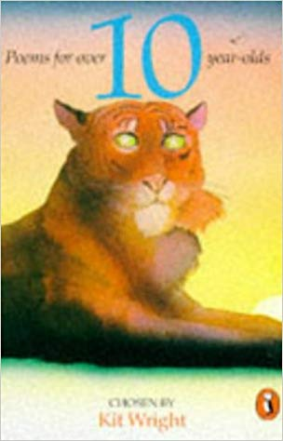








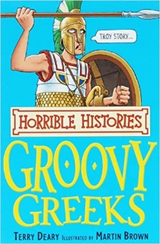





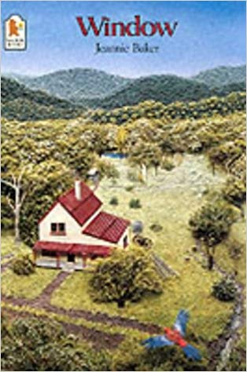

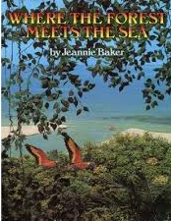




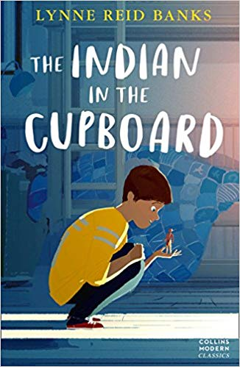
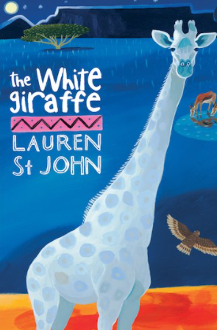
Search
Year Five’s Must Reads…Look for the Gold Star on the Spine!
Notes:
Book covers are animated by row – to change the pictures without breaking the animation, right-click on the image and select ‘change picture’, then add your chosen book cover ☺
Jane Hill, Learning Resource Manager, Kings Langley Secondary School, 2019.

